Slide 2
Jefferson Township High School December 14th, 2016
Introduction
What is Turnitin Feedback Studio?
Feedback Studio Walk-through
Supporting Academic Integrity
Additional Resources
Questions
Training & Professional Development
Notes:
During today’s session, we’ll be combining the use of a PowerPoint deck for reference and spending time online in Turnitin via a guided tour or “walkthrough.”
Next: What is Turnitin?

Slide 3
Introduction
Chris McClure
Customer Success Consultant
cmcclure@turnitin.com
Training & Professional Development

Slide 4
What is Feedback Studio?
What do you know about Turnitin Feedback Studio?
Feedback Studio is an instructional tool comprising three main services:
Similarity Check
Online Grading & Feedback
Peer Review
Training & Professional Development
Notes:
As the leader in “plagiarism prevention,” Turnitin has made a name for itself as the “plagiarism police,” but that’s not actually how the service is intended to work. I’d like to start us off today by talking about some of the misconceptions that attach to Turnitin and to Turnitin use.
Blue: >= 0 and < 20%
Green: >= 20 and < 40%
Yellow: >= 40 and < 60%
Orange: >= 60 and < 80%
Red: >= 80 and <= 100%

Slide 5
Session Goals
My goals for you this session:
Understand how teachers use Feedback Studio
Learn best practices for application in the classroom
Become familiar with interpreting Similarity Reports and the functionality of Online Grading & Feedback
What are your goals for this session?
Training & Professional Development
Notes:
As the leader in “plagiarism prevention,” Turnitin has made a name for itself as the “plagiarism police,” but that’s not actually how the service is intended to work. I’d like to start us off today by talking about some of the misconceptions that attach to Turnitin and to Turnitin use.
Blue: >= 0 and < 20%
Green: >= 20 and < 40%
Yellow: >= 40 and < 60%
Orange: >= 60 and < 80%
Red: >= 80 and <= 100%

Slide 6
Feedback Studio Misconceptions
Detects plagiarism
Matches are coincidental
Matches identified are the exact source
Training & Professional Development
Notes:
The first—and a big one—is that Turnitin detects plagiarism. Turnitin matches to text in our database and leaves the judgment up to the instructor. Instructors must look at the Originality Reports to determine if there is a problem. Instructors must interpret the paper’s Similarity Index score in the context of the assignment and the actual writing
Next, there may be a sense that matched text is likely completely coincidental or common knowledge. The likelihood that a 16-word match is “just a coincidence” is less than 1 in a trillion. Turnitin also includes the ability to exclude “small matches” if the instructor wants to exclude common phrases.
When we take a look at the Originality Reports, you’ll see the “Similarity Index,” which is a percentage score that shows how much of a submitted paper matches to pre-existing source material. There are a couple of misconceptions around the Similarity Index that I wanted to share with you now. There is the misconception that the “Similarity Index” shows the percentage of a paper that is plagiarized. There is also the mistaken belief that there is some “acceptable” threshold of a Similarity Index such as < 10% or 15%. Don’t worry, we’ll soon see what this looks like on the site. I want you to just keep these misconceptions in mind as we review.
Q: The source named in the Originality Report is the exact source used by the writer
A: There can be many matches because of the amount of duplication on the web. The source named may not be the exact source the student used.
NEXT SLIDE: Originality Check

Slide 7
SIMILARITY
CHECKING
Notes:
Let’s turn our attention now to Turnitin’s Originality Check. I’m going to start with a few prepared slides, and then we’ll move to Trunk.

Slide 8
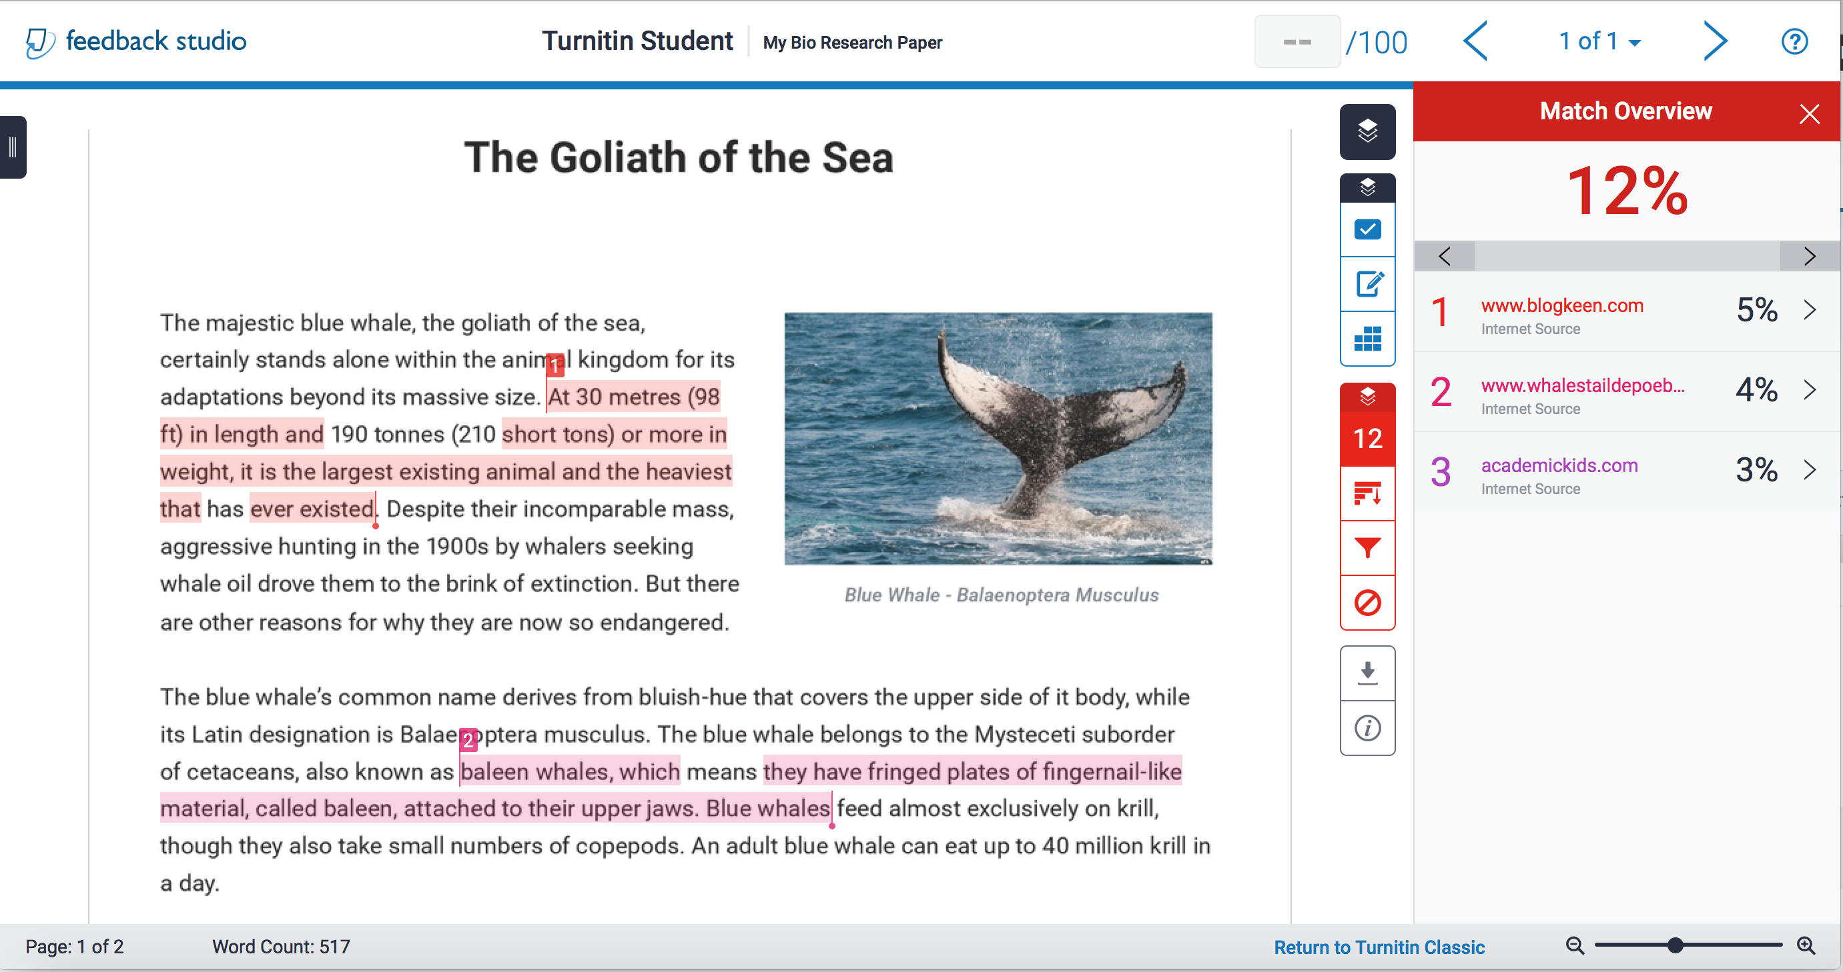
SIMILARITY CHECK
Identifies matched content by comparing papers against:
60 billion current & archived web pages
600 million student papers
130 million academic articles
Notes:
This is what an Originality Report from OriginalityCheck looks like.
On the left side of the screenshot is the student’s paper… displayed with all of its original formatting, including photos and illustrations. Anything that has matched to something in our database is highlighted in color and matched with a number on the right, which shows the source of the match and gives the link. Sometimes an item will have multiple matches and it will match to multiple sources because there is a lot of duplication on the web, and you can click on each source to see all the additional overlapping sources that the text matches to. The Originality Report includes a similarity index, computed as the percentage of text that matches sources in our database.

Slide 9
ONLINE GRADING
& FEEDBACK

Slide 10
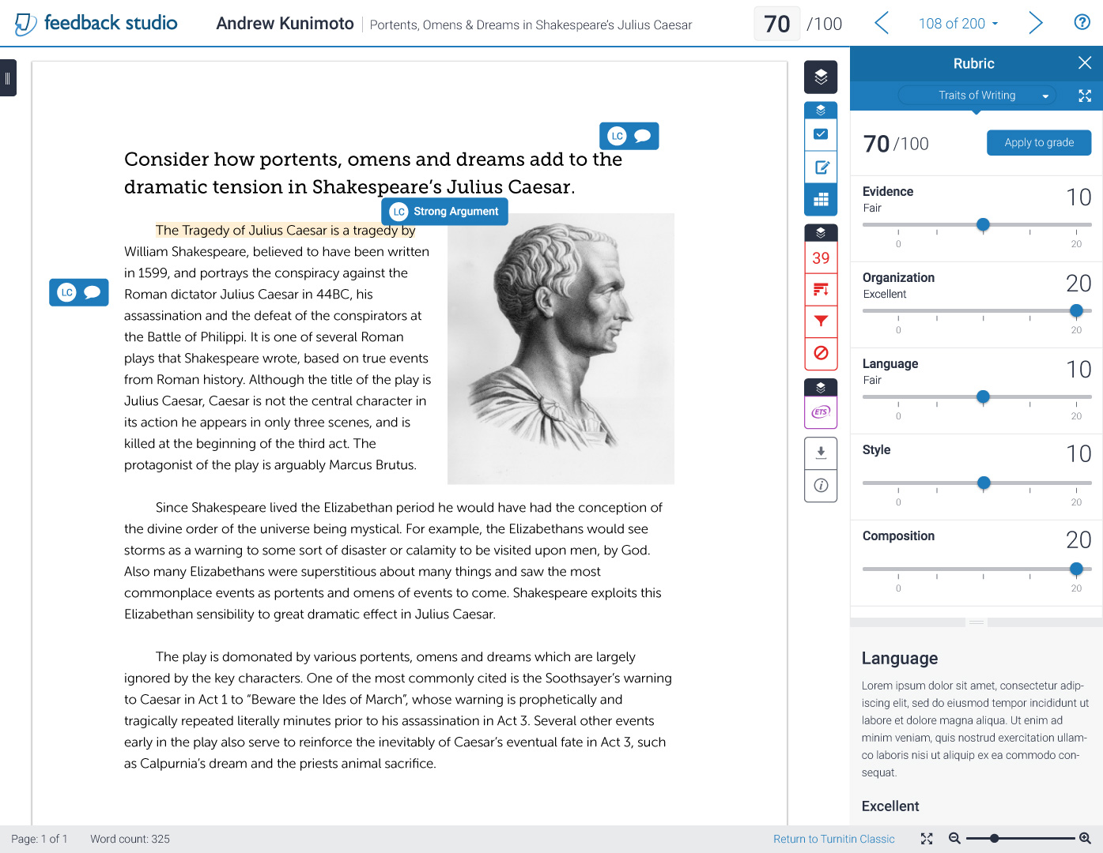
Grading & Feedback
Notes:
Here is the instructor’s view of GradeMark, our online marking & grading tool that includes the ETS grammar engine.
On the right is the pallet of blue QuickMarks, some of which have been dropped onto the paper. You can see the ‘Awk’ mark opened on the paper with the explanation of ‘Awkward.’
The purple marks are from ETS and you can see that it’s identifying some of the spelling, style and mechanics issues. From here, it’s very easy for instructors to leave feedback using:
Pre-set QuickMarks or Custom QuickMarks created ‘on the fly’ & stored in convenient Libraries for future access
- Voice Comments
Rubrics, and - General Comments
…and then transfer the student’s grade into a Gradebook within Turnitin.
Additionally, the Originality Report can be overlaid onto this GradeMark view so the instructor can comment on the content matches to teach proper citation methods and see a more comprehensive view of all the feedback on the paper.
So it’s very easy for instructors to save grading time while increasing the quality of their feedback. We expect that in a few years, most papers will be graded using online tools like GradeMark.

Slide 11
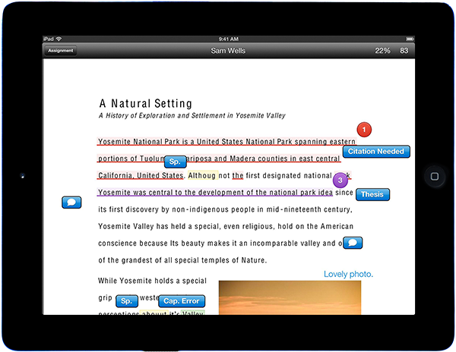
Go Mobile with Feedback Studio for iPad
Training & Professional Development
iPad is a trademark of Apple Inc.

Slide 12
Feedback Studio
Walk-through

Slide 13
ACADEMIC
INTEGRITY
Notes:
Many of the schools and districts that adopt Turnitin, implement it with the intent of using the service as a way to support their institutional academic integrity policies.

Slide 14
Sample Academic Integrity Statement
Additional copy to include:
“In support of Academic Integrity at <your institution>, Turnitin Feedback Studio will be used to review the papers that you submit in this course. Turnitin does not determine whether plagiarism has taken place or not. Turnitin will also not be used as a punitive tool or measure. The instructor of this class will use the reports that Turnitin generates as a basis for the thorough evaluation of the authenticity and originality of your work and the work of your classmates.”
Training & Professional Development
Notes:
As a way to inform students about Turnitin’s use at the class level and its use to support your academic integrity policy, I’d suggest that instructors include specific mention of the institution’s stance on plagiarism in their syllabi. I would encourage you to add more detail to this. In our experience working with institutions—it’s better to be more explicit in what might constitute plagiarism. Here is some additional copy on the use of Turnitin that I also encourage you to include…
This is sample copy that you are free to use. Adjust the copy as you see fit. From the standpoint of best practices in using Turnitin, institutions that have their instructors include information about Turnitin in their syllabi report seeing significant results in ensuring originality in student work.
NEXT SLIDE: Strategies

Slide 15
ADDITIONAL RESOURCES
Notes:
Let me turn to some additional resources that are available to you. Then, we’ll move to take any additional questions.

Slide 16
Additional Resources
Live Expert Trainings
http://go.turnitin.com/live-expert-training
Turnitin Feedback Studio Success Kit located at:
Guides.turnitin.com
Help Center:
http://www.turnitin.com/en_us/support/help-center
Call the Turnitin Help Desk!
866-816-5046 x 241
Training & Professional Development

Slide 17
Questions?
Notes:
Let me turn to some additional resources that are available to you. Then, we’ll move to take any additional questions.

Slide 18
Thank you!
Chris McClure
Customer Success Consultant
cmcclure@turnitin.com
Training & Professional Development

